Slide 1

Human Resource Management
ADVENTURE WORK COMPANY
EXECUTIVE PRESENTATION

Slide 2





Slide 3
Human Resources Department Overview
Our Eighth Year
This year...
290
$108M
17
16
6
36
Total Sales
Total Departments
Average Age
Total No. Employees
Total Sales - Person
Total Department Group

Slide 4

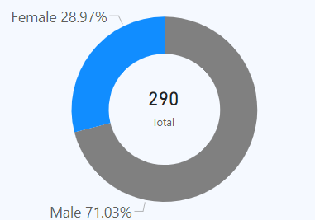
Assessing Gender Representation: Male-Dominated Workforce By 71%.
Gender Distribution

Slide 5
What are importance of gender diversity in modern workplaces?
Enhanced Creativity and Innovation: 60% of companies with a gender-diverse workforce report increased profits and productivity
Improved Decision-Making: Diverse teams make better decisions 87% of the time compared to non-diverse teams
Attraction and Retention of Talent: Companies that embrace gender diversity access a wider talent pool, with a McKinsey report showing that diverse teams are 35% more likely to outperform their industry's median financial returns.
Enhanced Financial Performance: Companies with gender-diverse teams are 21% more likely to outperform on profitability.
Strengthened Company Reputation: Gender diversity boosts a company’s image, showing it values equality and inclusivity, which appeals to customers and clients.

Slide 6
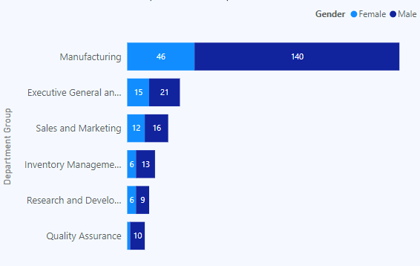
Gender In Balance Across Departments.
Gender Distribution Across Departments Group

Slide 7
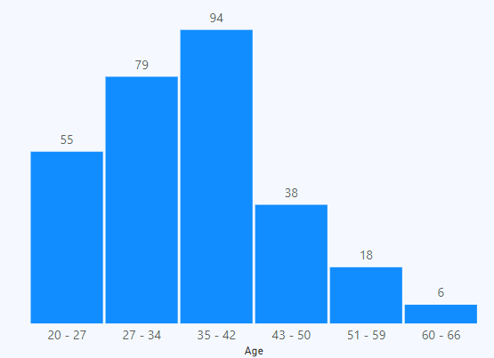
Employee Age Distribution: Majority in the 35-42 Age Range, with 94 Employees.
Employee Age Distribution

Slide 8
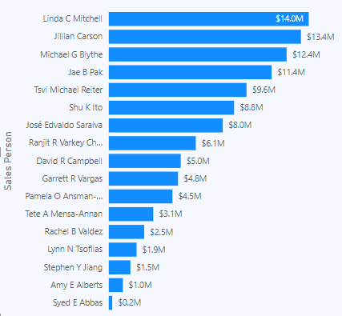
Driving Success: 86% of Total Sales Come from the Top 10 Salespeople.
Sales Revenue by Salesperson

Slide 9
Actions HR can Take to Boost the Company Efficiency
Recommendation
The Manufacturing department has 75.3% male and 24.7% female employees. To improve diversity, the goal is to raise female representation by 5% in the next 12 months, supporting the company’s focus on inclusion, with progress reviewed quarterly..
Manufacturing Department
The company's average employee age is 36, with 6 employees over 60. To manage the aging workforce and maintain efficiency, we recommend setting a retirement age cutoff at 60. This will open opportunities for younger talent and should be reviewed annually for impact.
Age Distribution
The Quality Assurance department has 83.3% male and 16.7% female employees. The company plans to increase female representation by 10% in the next 12 months through inclusive hiring, aligned with its diversity goals, with quarterly and annual progress reviews.
Quality Assurance department
A quarterly reward system will reward the top three sales performers, aiming for a 10% sales improvement. It aligns with company goals and uses existing resources, with rewards given two weeks after each quarter.
Rewarding Top 3 Sales-Person
The bottom 10 salespeople will join a mentorship and sales training program to boost performance by 15% over two quarters, with progress tracked monthly and a final review after six months.
Mentorship &Training

Slide 10

Thanks!
Do you have any questions?
Dkemboi888@Gmail.com
+254 724 006 132

